Slide 1
Procrastination & Boolean Arithmetic
Combating Procrastination, Overview of Numbers in Binary, Boolean Arithmetic, Circuits for Adding Binary Numbers

Slide 2
Project 2 Check-in
How has Project 2 been coming along?
What questions do you have about Project 2?
Following the plan of action outlined in slide 20 of last Thursday’s lecture will work for implementing most chips
Remember to double check your submission on GitLab
  Navigate to GitLab, open tags, and verify that the associated commit includes your expected changes

Slide 3
Lecture Outline
Combating Procrastination
  Procrastination Reflection and Avoidance Tips
Overview of Numbers in Binary
  Comparison Between Binary and Decimal
Boolean Arithmetic
  Addition Operator and Handling Binary Overflow
Circuits for Adding Binary Numbers
  Overview of the Half Adder and Full Adder

Slide 4
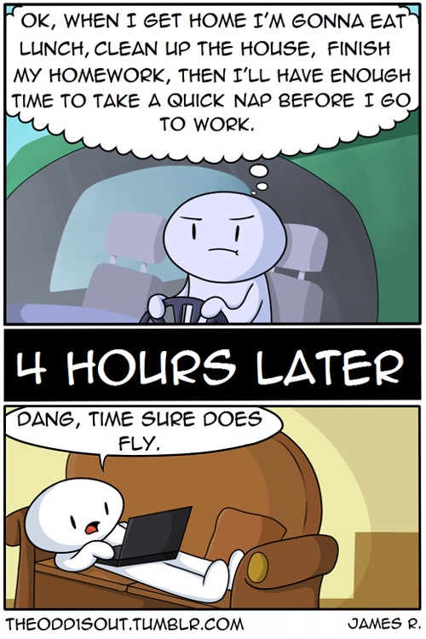
Let’s Talk Procrastination
What is procrastination?
  Procrastination is the act of putting things off or choosing to do something you prefer to do (or might even need to do) instead of the actual project or chore or work you need to be doing now
  Common challenge for college students, with about 80-95% of students reporting that they procrastinate (Steel, 2007)
Steel, Piers. “The nature of procrastination: a meta-analytic and theoretical review of quintessential self-regulatory failure.” Psychological Bulletin Journal 133, no. 1 (2007): 65–94. https://www.researchgate.net/publication/6598646_The_nature_of_procrastination_a_meta-analytic_and_theoretical_review_of_quintessential_self-regulatory_failure_Psychol_Bull_133_65-94

Slide 5
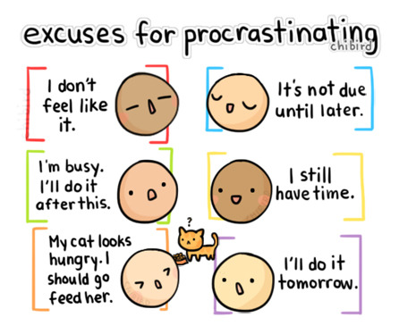
Combating Procrastination
Identifying why we procrastinate and the internal dialogue we have with ourselves
Create a proactive strategy to course-correct when you notice you're putting off what needs to be done

Slide 6
Grab a piece of paper!

Slide 7
Grab a piece of paper!
AVOIDANCE AREAS
When you procrastinate, what do you avoid doing?
Identify 3-5 areas

Slide 8
Where does procrastination impact you most?
PERSONAL
Eating well
Exercising / Wellness activities
Getting enough sleep
Bathing & hygiene
Health care (i.e. doctor’s visit)
Balancing bank account
Relaxation & hobbies
SCHOOL/COLLEGE
Going to class
Doing class readings
Studying for tests/exams
Doing homework/ assignments
Writing papers
Starting long-term projects
Finding a study group
Talking to an instructor or TA
Making an advising appointment
SHOPPING/HOME/
MAINTENANCE
Paying bills
Getting financial aid taken care of (i.e. FAFSA, forms, etc)
Doing laundry
Cleaning
Grocery shopping
Doing dishes
SOCIAL/RELATIONSHIPS
Talking with friends
Writing email responses
Socializing
Calling relatives
WORK/CAREER
Going to work
Applying to internships/jobs
Preparing a resume
Studying for interviews

Slide 9
Grab a piece of paper!
AVOIDANCE AREAS
PROCRASTINATION BEHAVIORS
When you procrastinate, what do you avoid doing?
How do you procrastinate?
In other words, what do you do instead of the work that needs to be done?
Identify 3-5 areas
Identify 3-5 behaviors

Slide 10
Grab a piece of paper!
AVOIDANCE AREAS
PROCRASTINATION BEHAVIORS
PLANNING FOR SUCCESS
When you procrastinate, what do you avoid doing?
How do you procrastinate?
In other words, what do you do instead of the work that needs to be done?
What can you do to avoid procrastination?
What action can you take to refocus yourself on the task you need to complete?
Identify 3-5 areas
Identify 3-5 behaviors
Identify 3-5 actions

Slide 11
Tips for Avoiding Procrastination
Prioritize the tasks that you need to complete
Plan for the tasks you need to complete
  Review your to-do list and schedule of upcoming events
Eliminate distractions that pull you away from focusing on the task at hand
  Isolate yourself from your phone, close distracting websites, etc.
Make productive behavior accessible and sources of procrastination harder to access

Slide 12
Lecture Outline
Combating Procrastination
  Procrastination Reflection and Avoidance Tips
Overview of Numbers in Binary
  Comparison Between Binary and Decimal
Boolean Arithmetic
  Addition Operator and Handling Binary Overflow
Circuits for Adding Binary Numbers
  Overview of the Half Adder and Full Adder

Slide 13
What is Binary?
A base n number system is a system of number representation with n symbols
Decimal system is a base 10 number system
  Base 10 symbols: 0, 1, 2, 3, 4, 5, 6, 7, 8, 9 (each called a digit)
  Increase a number by moving to the next greatest symbol
  Add another digit when we run out of symbols
Binary is a base 2 number system
  Base 2 symbols: 0, 1 (each called a bit)
  Often prefixed with 0b (e.g., 0b1101, 0b10)
  Least-significant bit (LSB): Lowest-order position of a binary value
  Most-significant bit (MSB): Highest-order position of a binary value

Slide 14
Representing Numbers in Base 2
Binary numbers are identical, except in base 2
  Describe a value by specifying multiples of powers of 2
  For example, a breakdown of 0b1101 in binary (13 in decimal)
Binary | Power of 2
0b1000 | 1 × 2³
0b0100 | 1 × 2²
0b0000 | 0 × 2¹
0b0001 | 1 × 2⁰

Slide 15
Binary vs. Decimal
Binary | Decimal
0b000 | 0
0b001 | 1
0b010 | 2
0b011 | 3
0b100 | 4
0b101 | 5
0b110 | 6
0b111 | 7
... | ...

Slide 16
What is the binary representation of the decimal value 29?
0b011011
0b011101
0b100011
0b100111
We’re lost…

Slide 17
Lecture Outline
Combating Procrastination
  Procrastination Reflection and Avoidance Tips
Overview of Numbers in Binary
  Comparison Between Binary and Decimal
Boolean Arithmetic
  Addition Operator and Handling Binary Overflow
Circuits for Adding Binary Numbers
  Overview of the Half Adder and Full Adder

Slide 18
Roadmap: Boolean Arithmetic
Addition
Subtraction
Comparison (<, >, ==, !=)
Multiplication
Division
Implement
Get it for free!
Get it for free!
Postpone to software
Postpone to software

Slide 19
Binary Addition
How do we add two binary numbers?
  As humans, we could convert to decimal and then back
Example: 0b101 + 0b010
  First convert 0b101 to decimal (result is 5)
  Next convert 0b010 to decimal (result is 2)
  Add the decimal numbers and convert back to binary
    5 + 2 = 7, which is 0b111 in binary
What’s more useful is understanding the rules of binary addition so we can teach them to a computer

Slide 20
Case Study: Decimal Addition
Consider how we perform decimal addition
  Right to left (least significant place to most significant place)
  When a column’s result is more than one digit, carry over the digit that overflows
Example:
carry
a | 5 | 7 | 8 | 3
b | 2 | 4 | 5 | 6
sum

Slide 21
Binary Addition
Binary addition conceptually the same as decimal addition
  Right to left (least significant place to most significant place)
  When a column’s result is more than one digit, carry over the bit that overflows
Example:
carry
a | 0 | 1 | 1 | 1
b | 0 | 1 | 0 | 1
sum

Slide 22
Binary Overflow
What if there’s a carry bit in the last column?
Example:
carry
a | 0 | 1 | 1 | 0
b | 1 | 0 | 1 | 0
sum

Slide 23
Binary Overflow
What if there’s a carry bit in the last column?
We can’t represent it in our fixed-width numbers
  We are going to “drop” or ignore the extra carry bit
carry
a |  | 0 | 1 | 1 | 0
b |  | 1 | 0 | 1 | 0
sum

Slide 24

Five-minute Break!
Feel free to stand up, stretch, use the restroom, drink some water, review your notes, or ask questions
We’ll be back at:

Slide 25
Lecture Outline
Combating Procrastination
  Procrastination Reflection and Avoidance Tips
Overview of Numbers in Binary
  Comparison Between Binary and Decimal
Boolean Arithmetic
  Addition Operator and Handling Binary Overflow
Circuits for Adding Binary Numbers
  Overview of the Half Adder and Full Adder

Slide 26
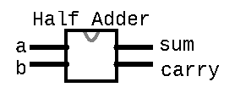
Half Adder
Circuit for adding two bits together
Takes in two inputs: a, b
  a is the first bit being added
  b is the corresponding bit to be added
carry
a | 0 | 1 | 1 | 0
b | 1 | 0 | 1 | 0
sum
Produces two outputs: sum, carry
  sum is the value to be put for this column in the result
  carry is the value to be carried over to the next column
/**
* Computes the sum of 2 bits
*/
CHIP HalfAdder {
  IN a, b;
  OUT sum, carry;
  PARTS:
  // Put your code here:
  }

Slide 27
Half Adder Example
Example: 0b0111 + 0b0101
For the right-most (least significant) column:
  a = 1
  b = 1
  sum =
  carry =
carry
a | 0 | 1 | 1 | 1
b | 0 | 1 | 0 | 1
sum

Slide 28
Half Adder Example
Boolean expressions:
  sum =
  carry =
a | b | sum | carry
0 | 0
0 | 1
1 | 0
1 | 1

Slide 29
Half Adder Group Work
Determine the half adder logical Boolean expression
  First, fill in the truth table values for sum and carry based on the inputs
  Then, develop a Boolean expression for sum and carry based on the truth table
Five-minute group discussion, identify one person to share each of the following as a large group:
  Overview of what the half adder does
  Thought process for reaching the Boolean expression for sum
  Thought process for reaching the Boolean expression for carry

Slide 30
Half Adder Example
Boolean expressions:
  sum = a XOR b
  carry = a AND b
a | b | sum | carry
0 | 0 | 0 | 0
0 | 1 | 1 | 0
1 | 0 | 1 | 0
1 | 1 | 0 | 1

Slide 31
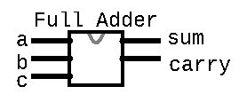
Full Adder
Circuit for adding three bits together (two bits and carry bit together from previous column)
  a is the first bit being added
  b is the corresponding bit to be added
  c is the carry bit from the right column
carry
a | 0 | 1 | 1 | 0
b | 1 | 0 | 1 | 0
sum
Produces two outputs: sum, carry
  sum is the value to be put for this column in the result
  carry is the value to be carried over to the next column
/**
* Computes the sum of 3 bits
*/
CHIP FullAdder {
  IN a, b, c;
  OUT sum, carry;
  PARTS:
  // Put your code here:
  }

Slide 32
Full Adder
Example: 0b0111 + 0b0101
For the second (second least significant) column:
  a = 1
  b = 0
  c = 1
  sum =
  carry =
carry |  |  | 1
a | 0 | 1 | 1 | 1
b | 0 | 1 | 0 | 1
sum |  |  |  | 0

Slide 33
Full Adder Truth Table
a | b | c | sum | carry
0 | 0 | 0
0 | 0 | 1
0 | 1 | 0
0 | 1 | 1
1 | 0 | 0
1 | 0 | 1
1 | 1 | 0
1 | 1 | 1

Slide 34
What are the sum and carry bits when a=0, b=1, and c=1?
a | b | c | sum | carry
0 | 0 | 0
0 | 0 | 1
0 | 1 | 0
0 | 1 | 1 | ? | ?
1 | 0 | 0
1 | 0 | 1
1 | 1 | 0
1 | 1 | 1
sum = 0, carry = 0
sum = 0, carry = 1
sum = 1, carry = 0
sum = 1, carry = 1
We’re lost…

Slide 35
What are the sum and carry bits when a=0, b=1, and c=1?
a | b | c | sum | carry
0 | 0 | 0
0 | 0 | 1
0 | 1 | 0
0 | 1 | 1 | 0 | 1
1 | 0 | 0
1 | 0 | 1
1 | 1 | 0
1 | 1 | 1
sum = 0, carry = 0
sum = 0, carry = 1
sum = 1, carry = 0
sum = 1, carry = 1
We’re lost…

Slide 36
Full Adder Truth Table
a | b | c | sum | carry
0 | 0 | 0 | 0 | 0
0 | 0 | 1 | 1 | 0
0 | 1 | 0 | 1 | 0
0 | 1 | 1 | 0 | 1
1 | 0 | 0 | 1 | 0
1 | 0 | 1 | 0 | 1
1 | 1 | 0 | 0 | 1
1 | 1 | 1 | 1 | 1

Slide 37
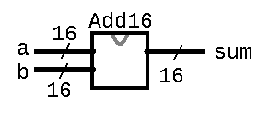
Multi-Bit Adder
Adds two 16-bit numbers
Connects the full adders for each column together (wires the out carry from one column to the in carry of the next)
/**
* Adds two 16-bit Two’s Complement
* values. Overflow is ignored.
*/
CHIP Add16 {
  IN a[16], b[16];
  OUT sum[16];
  PARTS:
  // Put your code here:
  }
… 0 1 1 1 0 0
… 0 0 1 0 1 0 1
… 1 0 1 1 1 0 0
+
… 1 1 1 0 0 0 1

Slide 38

Lecture 4 Wrap-up
Exciting lecture topics this Thursday!
  Metacognitive Subject: Growth vs. Fixed Mindset
  Technical Subject: Binary Number Representations and the ALU
Project 2 due this Thursday (10/13) at 11:59pm
Preston has office hours after class in CSE2 153
  Feel free to post your questions on the Ed board as well
Join the students only CSE 390B Discord channel!
  https://discord.gg/3ZTCPvgJeJ

